Slide 1


Hospital Facilities Catalog
Team Kanto: Eva Mui, David Merten-Jones, Aashish Sunar, Jennifer Long, Aishwarya Pandian

Slide 2
Agenda
01 | Project Background
02 | User Stories
03 | Demo – Application
04 | Test Strategies
05 | Project Plan and Methodology
06 | Remaining Work

Slide 3
Project Background

Slide 4
Background
A centralized web application for discovering healthcare services
Standardizes how hospitals publish medical service information
Helps patients find care options quickly
Enables providers to make informed referrals
Allows administrators to manage and update facility service listings
Improves transparency and access to healthcare services

Slide 5
User Story 1
As a patient, I want to search hospital facilities by name, city, or ZIP code in Los Angeles so I can quickly find the medical facility I need.

Slide 6
User Story 2
As a patient, I want to browse hospitals by facility type (e.g., urgent care, maternity care, pediatric services, veteran care, and psychiatric services) so I can quickly find the healthcare services I need.

Slide 7
User Story 3
As a patient, I want to view detailed provider information including name, address, phone number, ratings, and available service types (e.g., urgent care, maternity, pediatrics, veteran care, psychiatric services) so I can make informed decisions about my care.

Slide 8
Data Search &
Preparation

Slide 9
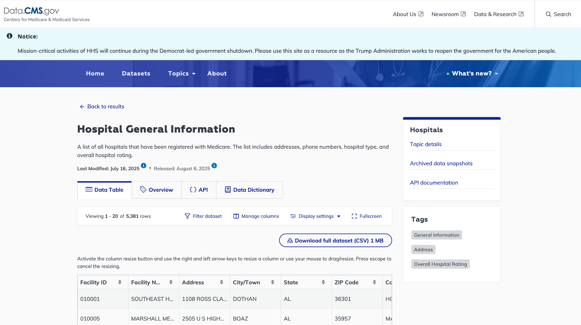
Data Search
•Only hospitals that have been registered with Medicare.
•The list includes contact information – addresses (city, zip), phone numbers,
•List also includes hospital type,(urgent care, psychiatry, veteran’s care) and overall hospital review/ratings.
https://data.cms.gov/provider-data/dataset/xubh-q36u#data-table ​

Slide 10
Data Preparation
Data cleaning and preprocessing was done in pandas.​
Fortunately, data was already mostly clean, but we did have to engineer new features for care categories, by one-hot encoding categories from the Hospital Type field.​
From here, we created a relational database in SQLite3 using SQLAlchemy. ​
Our hospital database is static at this point, but we do hope to implement a feature in a further iteration.
that would give providers the ability to update their facilities' information.​

Slide 11
Acceptance Criteria

Slide 12
Acceptance Criteria
User Story 1 : Search Hospital Facilities by Name, City, or ZIP code
As a patient, I want to search hospital facilities by name, city, or ZIP code in Los Angeles so I can quickly find the medical facility I need.
Acceptance Criteria:
•The search bar allows users to browse hospitals by name, ZIP, and location.
•The results page should display generic placeholder information such as hospital name, address, and city.
User Story 2 : Browse Facilities by Specialties
As a patient, I want to browse healthcare facilities by the medical specialties they offer so that I can quickly find the type of care I need.
Acceptance Criteria:
•The main page provides another search bar that allows users to browse hospitals by medical speciality.
•The results page should display available information for specialties such as Urgent Care, Veterans’ Care, Child/Pediatrics, Maternity Care, and Psychiatry.
•In the current iteration, these specialty categories have not yet been linked to the database, so the results page displays generic placeholder information rather than live data from the system.

Slide 13
Acceptance Criteria
User Story 3 - Login/Create Account
As a patient, I want to log in to my account so that I can securely search, store and access my medical information when needed.
Acceptance Criteria:
The main page provides a login button that allows administrators to enter a valid username and password.
When valid credentials are entered (Username: admin, Password: admin123), the administrator is redirected to the “Admin Dashboard” page.
If invalid credentials are entered, the system displays an error message indicating incorrect login details.
The main dashboard currently displays placeholders for “Admin Panel” and “Home” links, which are visible but not yet functional in this iteration.
The administrator can log out successfully, ending the current session and get redirected to the main page.

Slide 14
Demo Application
http://127.0.0.1:5000/

Slide 15
Test Strategies

Slide 16
Test Strategies
Hospital Search Functionality​
Positive and negative tests for hospitals search by name, city, or ZIP fields​
Testing partial search
Ensuring hospital pages display detailed information form correctly
User Account System​
New users can create accounts​
Positive and negative tests for login credentials and appropriate redirection
Prevent duplicate users​
Restricted User Access​
Protected pages like provider and admin dashboards should be inaccessible without login​

Slide 17
Project Plan & Methodology

Slide 18





Milestone 1
Iteration 1
Iteration 2
AS A PATIENT, I WANT TO SEARCH HOSPITAL FACILITIES BY NAME, CITY, OR ZIP CODE IN LOS ANGELES SO I CAN QUICKLY FIND THE MEDICAL FACILITY I NEED.
AS A PATIENT, I WANT TO BROWSE HOSPITALS BY FACILITY TYPE (E.G., URGENT CARE, MATERNITY CARE, PEDIATRIC SERVICES, VETERAN CARE, AND PSYCHIATRIC SERVICES) SO I CAN QUICKLY FIND THE HEALTHCARE SERVICES I NEED.
AS A PATIENT, I WANT TO VIEW DETAILED PROVIDER INFORMATION INCLUDING NAME, ADDRESS, PHONE NUMBER, RATINGS, AND AVAILABLE SERVICE TYPES (E.G., URGENT CARE, MATERNITY, PEDIATRICS, VETERAN CARE, PSYCHIATRIC SERVICES) SO I CAN MAKE INFORMED DECISIONS ABOUT MY CARE.

Slide 19
Key Tasks
Iteration 2 (4 weeks)
Create a landing page to allow user to search hospital facilities and browse hospital by facility type
Add functionality to search hospital facilities by name, city, and ZIP
Add functionality to browse hospital by facility type
Show relevant hospital search results and detailed facility information selected by the user
Each feature includes the following tasks:
UI/UX Design
Define Acceptance Criteria
Application Development
Test Development
Iteration 1 (2 weeks)
Identify publicly source facility & services datasets
Setup sqlite3 database
Implement schema and ingest CSV
Create a Skeleton web application with a landing page and basic login functionality

Slide 20
Milestone 1 Statistics
2 of 3 user stories completed
15 of 19 total tasks completed
23 issues closed, 4 remains open

Slide 21
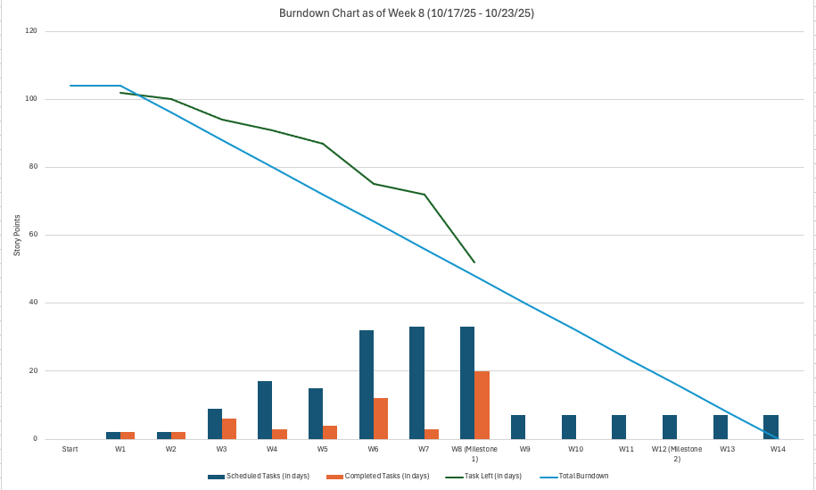
Project Status & Timeline

Slide 22
Team Roles
Eva Mui – Scrum Master
Aishwarya Pandian – Product Owner
David Merten-Jones – Backend Developer
Aashish Sunar – Frontend Developer
Jennifer Long - Designer and Test Engineer

Slide 23
Team Collaboration
Meetings
Status meetings: Tuesdays & Saturdays
Working coordination meeting: Saturdays
Ad-hoc in-person syncs before Thursday class (as needed)
Chat
Microsoft Teams for daily collaboration
Mobile chat group for quick coordination
Documentation & File Sharing
Shared Google Drive for project documents, plans, and deliverables

Slide 24
Team Performance
Milestone: 1
Iteration: 2
Time: 6 weeks
User Stories: 3
Velocity: 89.5%

Slide 25
Project Resources
Link to GitHub Repository and README:
https://github.com/davidmertenjones/ist-303-team-kanto-project
Link to Project Dashboard:
https://github.com/users/davidmertenjones/projects/1
Link to issues:
https://github.com/davidmertenjones/ist-303-team-kanto-project/issues

Slide 26
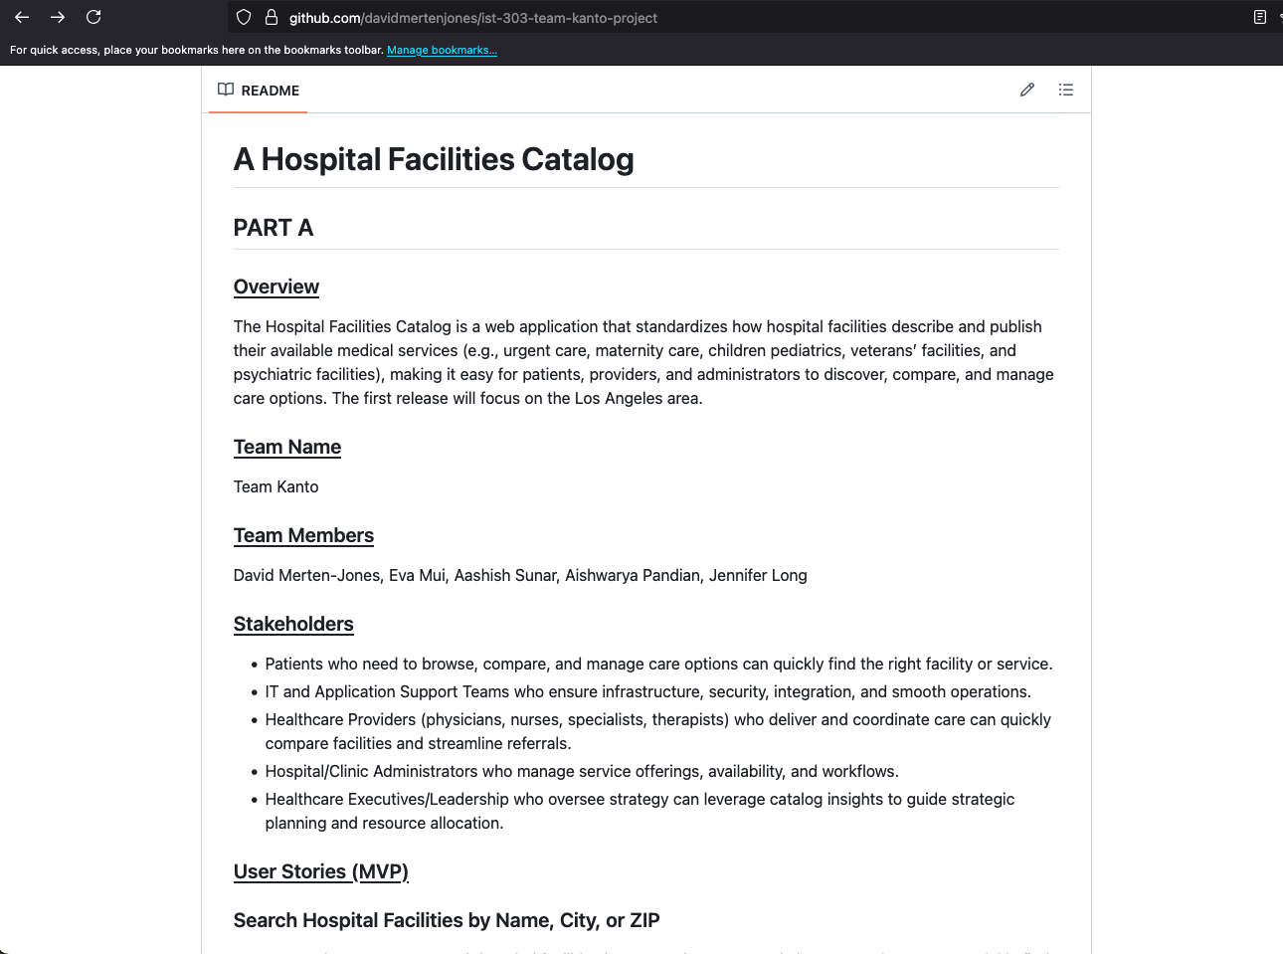
GitHub Repository

Slide 27
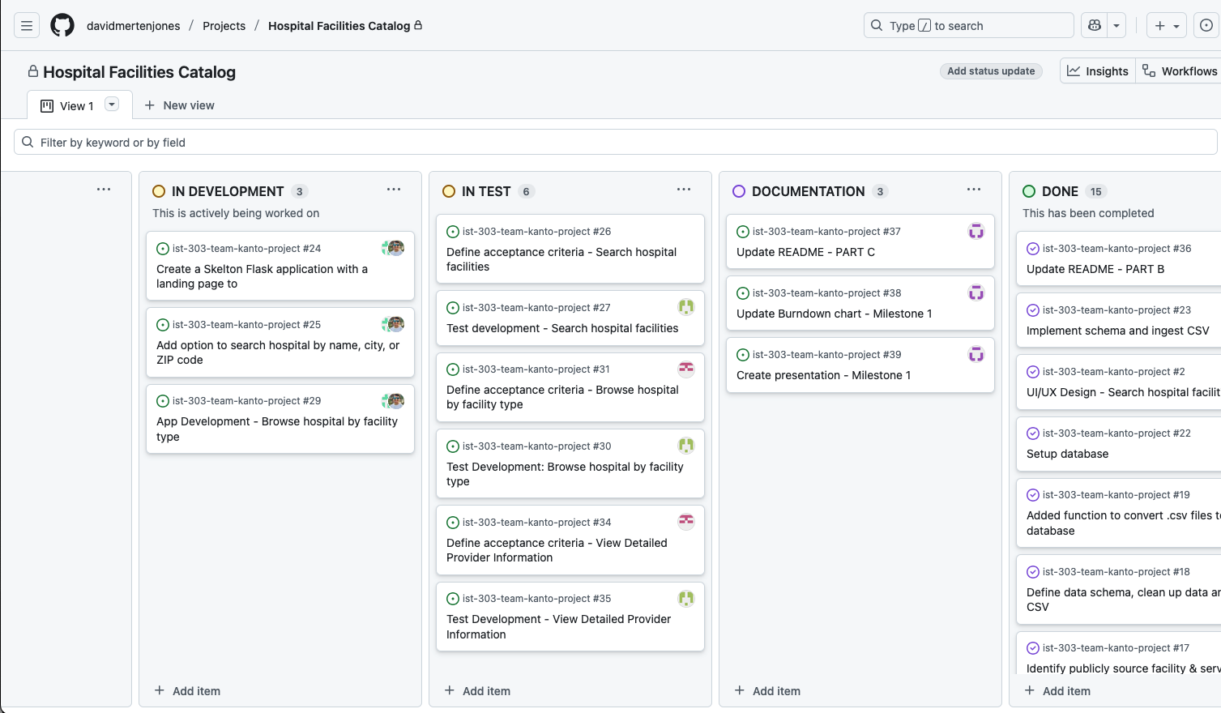
Project Dashboard

Slide 28
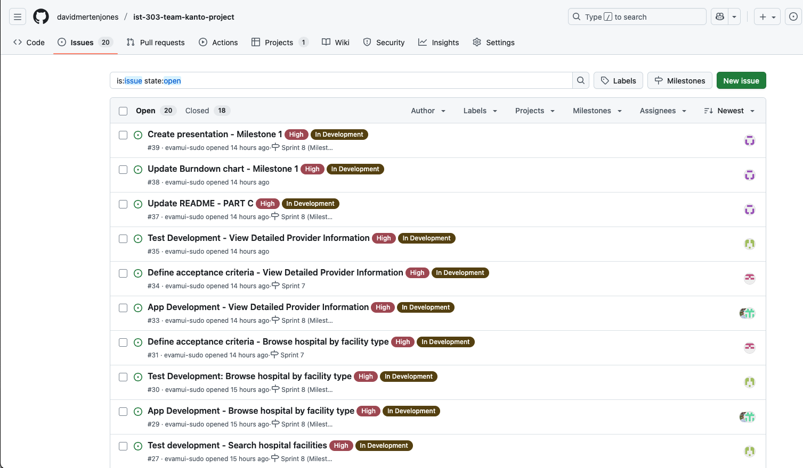
Project Issues

Slide 29
Remaining Work

Slide 30
Milestone 2
User Story 4: As an IT administrator or application support team member, I want the ability to create and manage user accounts and assign role-specific access to services, configurations, settings, and tools so that users have the appropriate permissions.
User Story 5: As a healthcare provider, I want to view the types of services available at my facility (e.g., urgent care, maternity, pediatrics, veteran care, psychiatric services) so I can recommend appropriate options to patients.
User Story 6: As a hospital or clinic administrator, I want to add, update, or remove the services offered by my facility so that the information remains accurate and up to date for users.
User Story 7: As a patient, I want to view and submit ratings and feedback for services I’ve received so I can share my experience with other patients and provide input to the hospital for improvement.

Slide 31
Questions?

Slide 32
References
How and When to Use Sqlite https://www.digitalocean.com/community/tutorials/how-and-when-to-use-sqlite
Pilone, D., and Miles, R. Head First Software Development. O’Reilly. 2008. 978-0- 596-52735-8. (Available at https://ccl.on.worldcat.org/oclc/213482767)
Lubanovic, B. Introducing Python. O’Reilly. 2015. 978-1-449-35936-2. (Available at https://ccl.on.worldcat.org/oclc/1127579360)
Okken, B. Python Testing with pytest. The Pragmatic Programmers. 2017. 978-1- 68050-240-4. (Available at https://ccl.on.worldcat.org/oclc/1014021663)
CMS Hospital General Information https://data.cms.gov/provider-data/dataset/xubh-q36u#data-table
Team Kanto Github https://github.com/davidmertenjones/ist-303-team-kanto-project

Slide 33
Section header

Slide 34
Section header

Slide 36
REPLACE TEXT

Slide 37
Timeline
Add an event
Add an event
Add an event
Write a description of the significance of this event
Write a description of the significance of this event
Write a description of the significance of this event
Add an event
Add an event
Write a description of the significance of this event
Write a description of the significance of this event

